Slide 1
Lesson 4: Support Vector Machine (SVM)

Slide 2
Today's Agenda
Maximum Margin
Hinge loss
SVM with linear kernel
Kernel tricks
SVM with polynomial kernel
SVM with radial basis function kernel
Support Vector Regression

Slide 3
Learning Objectives
By the end of this session, you should be able to:
Describe the intuition behind maximum margin.
Differentiate hinge loss from other losses.
Define kernel tricks and how to effect implicit feature transformation using kernels.
Describe how similarity is computed using the polynomial kernel.
Produce a support vector machine classification model based on polynomial kernel and radial basis function kernel.
Produce a support vector machine regression model with a statistically significant improvement over the null model.

Slide 4
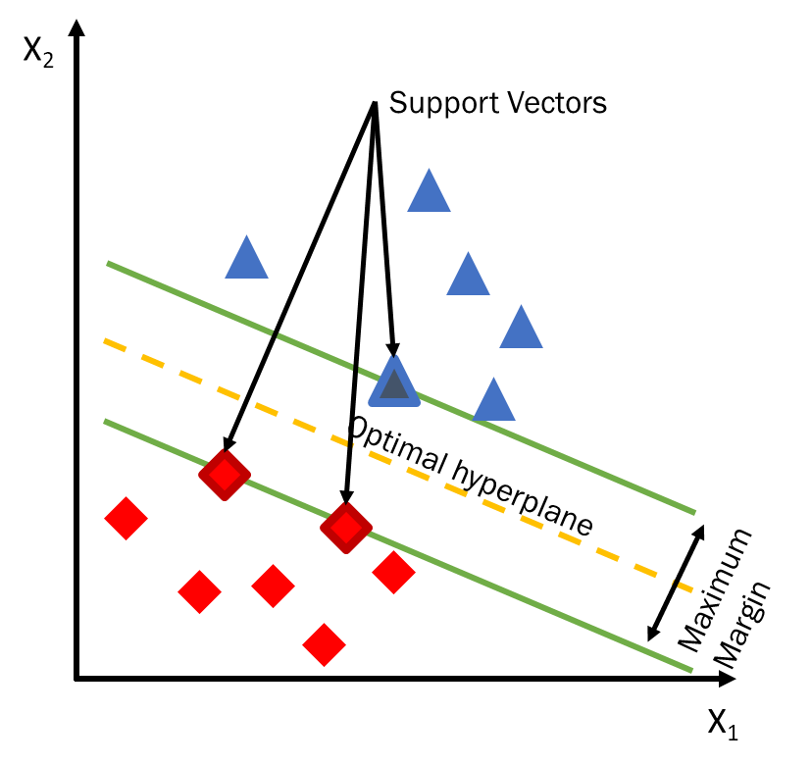
SVMs in a Nutshell…
SVM views the input data points as two sets of vectors in an n-dimensional space (where n is the number of features)
It constructs two vectors that maximize the margin (distance) between the inner most training data points based on their “similarity”
The optimal solution boundary is an equidistant line in between the two margins called a hyperplane

Slide 5
Linear Model
Binary classification can be viewed as the task of separating classes in feature space
w^{T}x + b = 0
w^{T}x + b > 0
w^{T}x + b < 0
f(x) = sign(w^{T}x + b)

Slide 6
Wide Margin Intuition
Which of the linear decision boundary is optimal?

Slide 7
Intuition of Margin
A
w^{T}x + b = 0
Consider points A, B, and C.
We are quite confident in our prediction for A because it’s far from the decision boundary.
In contrast, we are not so confident in our prediction for C because a slight change in the decision boundary may flip the decision.
B
C

Slide 8
Goal of Learning
Given a training set, we would like to make all our predictions correct and confident! This can be captured by the concept of margin.

Slide 9
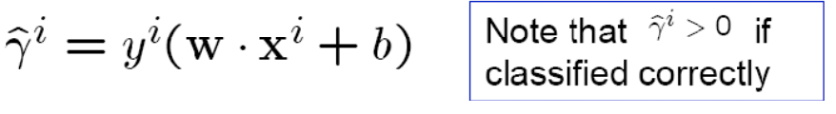
Functional Margin
We define this as the functional margin of the linear classifier with respect to the training example (x^{i}, y^{i})
The large the value, the better?
What if we rescale (W, b) by a factor of ⍺?
Decision boundary remains the same.
Yet, functional margin gets multiplied by ⍺.

Slide 10
Geometric Margin
A
w^{T}x + b = 0
What we really want is the distances between the examples and the decision boundary to be large.
This distance is called geometric margin.
How do we compute the geometric margin of a data point with respect to a particular line parameterized by W and b.
B
C

Slide 11
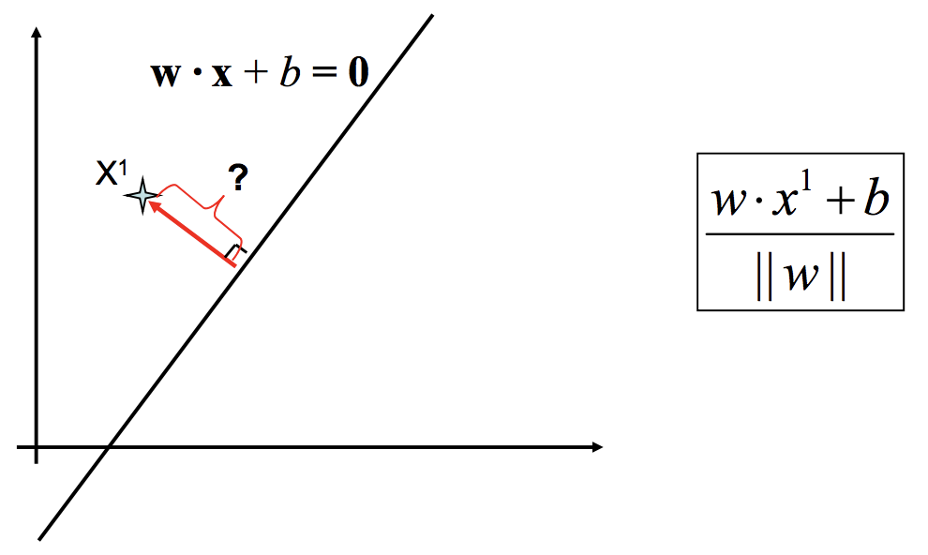

How to calculate the distance of a point to a line?

Slide 12
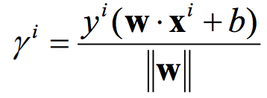
Maximize the Geometric Margin
The geometric margin of x^{i} with respect to (W, b) is the distance from x^{i} to the decision surface.
This distance can be computed as
Examples closest to the hyperplane are support vectors.
r

Slide 13

Maximize the Geometric Margin
ρ
Given a training set, the geometric margin of the classifier with respect to this training set is:
Margin ρ of the separator is the distance between support vectors.
r

Slide 14
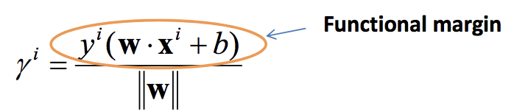
Geometric Margin vs. Functional Margin
The Geometric Margin of a training example EQUALS the Functional Margin normalized by the magnitude magnitude of w.

Slide 15
Quick Recap
We want to find a linear decision boundary whose margin is the largest.
We know how to measure the margin of a linear decision boundary.
We have a new learning objective. Given a linearly separable training set, we would like to find a linear classifier with maximum margin.

Slide 16
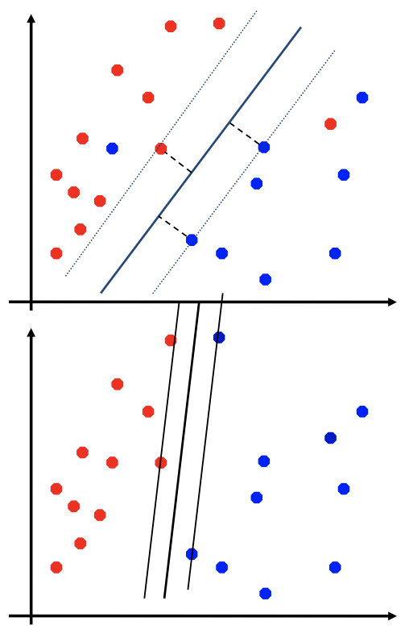
Non-separable Data and Noise
What if the data is not linearly separable?
We may have noise in data, and maximum margin classifier is not robust to noise!

Slide 17
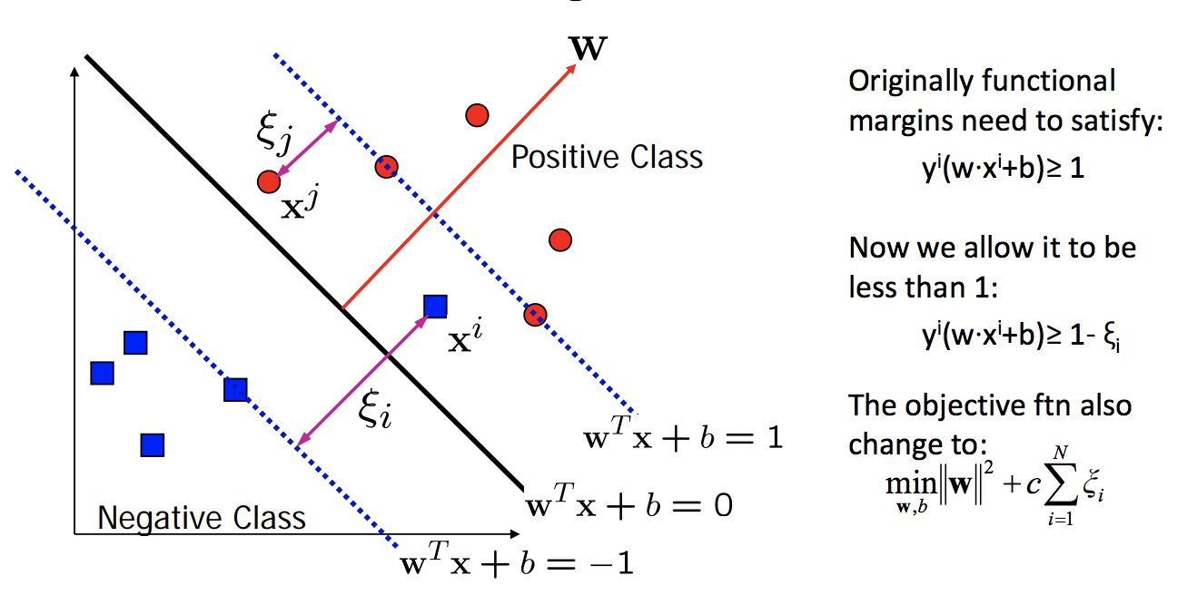
Soft Margin
Allow functional margins to be less than 1.
Slack variables ξ_{i} can be added to allow misclassification of difficult or noisy examples, resulting margin called soft margin.

Slide 18
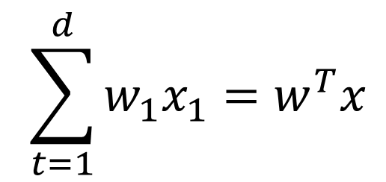


Find an Optimum Decision Boundary
Decision boundaries classify all the data points correctly
Several hyperplanes may satisfy this requirement
For SVMs, we are looking for the Euclidean dot product calculated as follows:
$$w^{T}x =0$$
$$\sum_{t=1}^{d}{w_{1}x_{1}=w^{T}x}$$
$$\left\|w\right\|=\sqrt{a^{2}+b^{2}}$$
Notes:
As with any linear technique, our goal is to define a decision boundary that classifies all points correctly. However, as we saw with linear regression, several hyperplanes could do this.
Only one is optimal—the one that maximizes the distance between ALL of the datapoints.
With SVM we do this by calculating the sum of the weights times the feature vectors—or the Euclidean dot product which from here on I will use the simplified notation w^T times x.
To derive the optimal hyperplane though, we must first generate the support vectors.

Slide 19
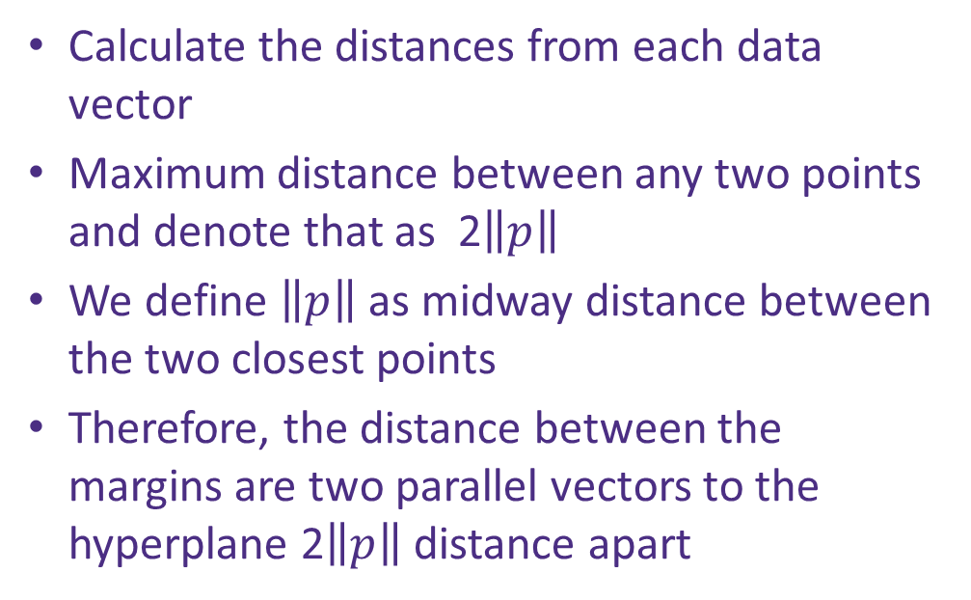


Find the Maximum Margin
Calculate the distances from each data vector
Maximum distance between any two points and denote that as 2$\left\|p\right\|$
We define $\left\|p\right\|$ as midway distance between the two closest points
Therefore, the distance between the margins are two parallel vectors to the hyperplane 2$\left\|p\right\|$ distance apart
$$w^{T}x =0$$
$$w^{T}x =1$$
$$w^{T}x =−1$$
Notes:
Let’s start with a few definitions to support the diagrams to follow.
Our goal is to find a decision boundary that maximizes the distance between all datapoint vectors. This boundary is a perpendicular line mathematically centered between the two support vectors we are generating based on the distances of separation in the vector space.
Those points on or above the upper support vector are labeled 1 and those below the lower support vector are labelled -1. p represents the distance to the decision boundary and 2p is the full width between the upper and lower support vectors.

Slide 20

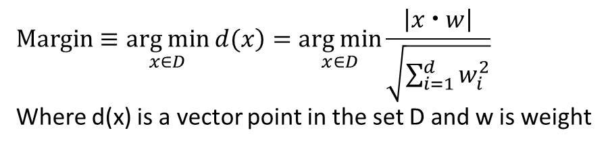
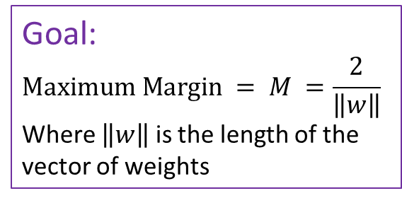
Find the Optimal Hyperplane
$$Margin≡\underset{x∈D}{arg min}\left. d(x\right)=\underset{x∈D}{arg min}{\frac{\left|x  w\right|}{\sqrt{\sum_{i=1}^{d}{w_{i}^{2}}}}}$$
Where d(x) is a vector point in the set D and w is weight
X₂
The optimal hyperplane is the orthogonal projection of a perpendicular line that is the maximum distance from all of the vectors
Goal:
$$Maximum Margin = M =\frac{2}{\left\|w\right\|}$$
Where $\left\|w\right\|$ is the length of the
vector of weights
$$M$$
X₁
Notes:
When we are early in our calculations—say only have two datapoints--the maximum margin is simply the distance between those two points.

Slide 21




Find the Optimal Hyperplane
$$Margin≡\underset{x∈D}{arg min}\left. d(x\right)=\underset{x∈D}{arg min}{\frac{\left|x  w\right|}{\sqrt{\sum_{i=1}^{d}{w_{i}^{2}}}}}$$
Where d(x) is a vector point in the set D and w is weight
X₂
$$w^{t}x+=1$$
At each new datapoint
Select two hyperplanes which separate the data point with no points between them
maximize their distance (the margin)
Half the distance is the optimal hyperplane
$$w^{T}x =0$$
Optimal hyperplane
Goal:
$$Maximum Margin = M =\frac{2}{\left\|w\right\|}$$
Where $\left\|w\right\|$ is the length of the
vector of weights
$$w^{t}x=−1$$
$$M$$
X₁
Notes:
As we have more datapoints we can use these to create the support vectors that maximize the distance with all of the datapoints or M in the diagram.

Slide 22




Find the Optimal Hyperplane
$$Margin≡\underset{x∈D}{arg min}\left. d(x\right)=\underset{x∈D}{arg min}{\frac{\left|x  w\right|}{\sqrt{\sum_{i=1}^{d}{w_{i}^{2}}}}}$$
Where d(x) is a vector point in the set D and w is weight
X₂
At each new datapoint
Select two hyperplanes which separate the datapoint with no points between them
maximize their distance (the margin)
Half the distance is the optimal hyperplane
$$w^{t}x+=1$$
$$w^{T}x =0$$
Optimal hyperplane
Goal:
$$Maximum Margin = M =\frac{2}{\left\|w\right\|}$$
Where $\left\|w\right\|$ is the length of the
vector of weights
$$w^{t}x=−1$$
$$M$$
X₁
Notes:
The more datapoints, the more the road narrows—I think this looks like a road with the dotted line in between to represent the dotted line on a road. Keep in mind that the lanes on either side of this dotted line are always equidistant. In fact, what we are recalculating are the support vectors. The optimal boundary is always the perpendicular line between them.

Slide 23




Find the Optimal Hyperplane
$$Margin≡\underset{x∈D}{arg min}\left. d(x\right)=\underset{x∈D}{arg min}{\frac{\left|x  w\right|}{\sqrt{\sum_{i=1}^{d}{w_{i}^{2}}}}}$$
Where d(x) is a vector point in the set D and w is weight
X₂
$$w^{t}x+=1$$
$$w^{T}x =0$$
$$w^{t}x=−1$$
Goal:
$$Maximum Margin = M =\frac{2}{\left\|w\right\|}$$
Where $\left\|w\right\|$ is the length of the
vector of weights
Optimal hyperplane
$$M$$
X₁
Notes:
Once all your datapoints are plotted and labeled (positive 1 for points above the upper support vector, negative ones below the lower support vector) your model is trained and you are ready to evaluate unseen data.

Slide 24




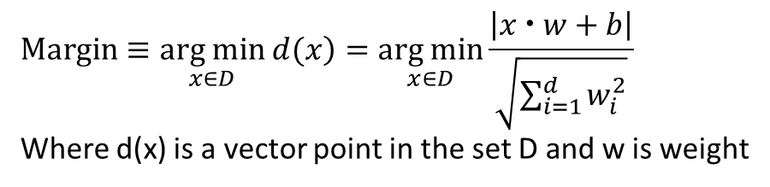
Find the Optimal Hyperplane
$$Margin≡\underset{x∈D}{arg min}\left. d(x\right)=\underset{x∈D}{arg min}{\frac{\left|x  w+b\right|}{\sqrt{\sum_{i=1}^{d}{w_{i}^{2}}}}}$$
Where d(x) is a vector point in the set D and w is weight
X₂
$$w^{t}x+=1$$
$$w^{T}x =0$$
$$w^{t}x=−1$$
Optimal hyperplane
Goal:
$$Maximum Margin = M =\frac{2}{\left\|w\right\|}$$
Where $\left\|w\right\|$ is the length of the
vector of weights
SVMs identify the convex hull
of each group… the smallest
convex set that contains D
$$M$$
X₁
Notes:
And because you know all the distances between datapoints and which fall into which category, you can also look for the minimum boundaries between those datapoints appearing above and below the support vector and draw a tighter cluster of datapoints or classes.
You might a slight change in the Margin calculation the “+b” in this equation is accounting for model bias.

Slide 25
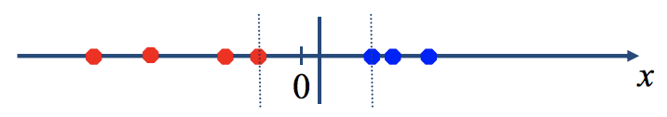
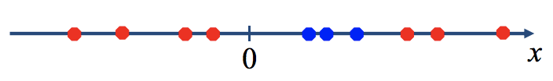
Non-linear SVM
Datasets that are linearly separable with some noise work out great.
But what are we going to do if the dataset is just too hard?

Slide 26
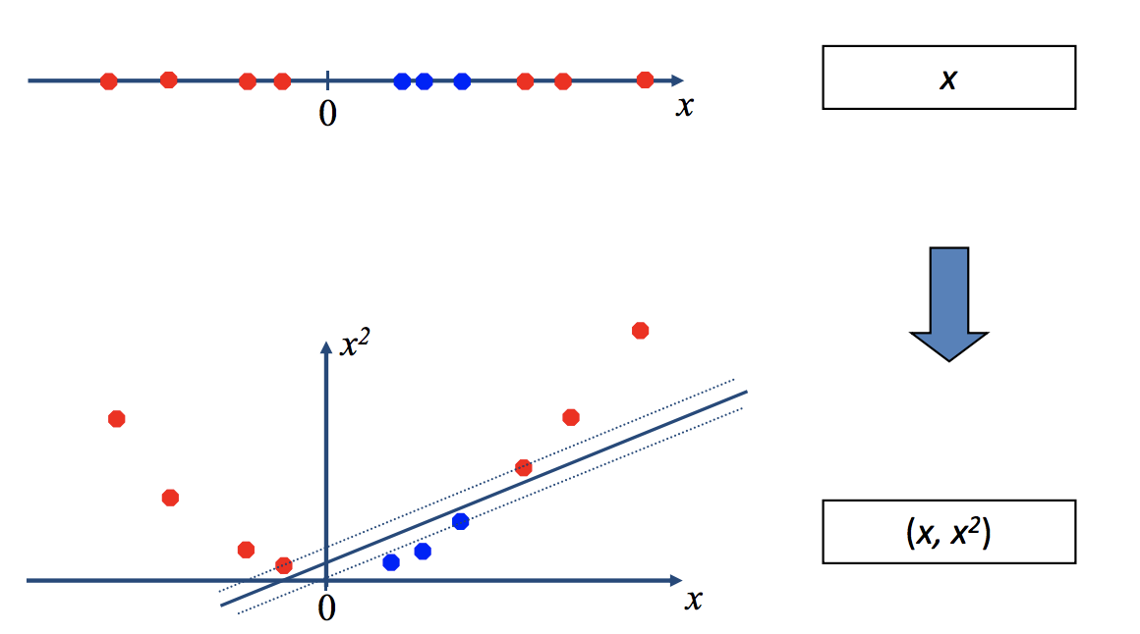
Map data into a higher dimensional space

Slide 27
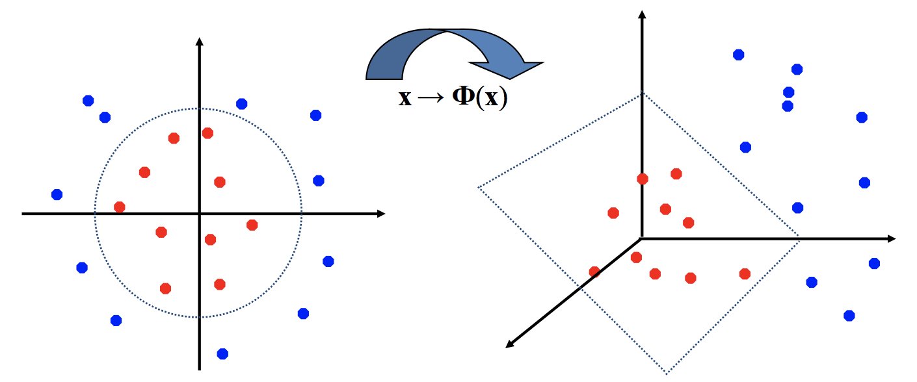
Non‐linear SVMs: Feature Spaces
General idea: the original feature space can always be mapped to some higher‐dimensional feature space such that the train data is linearly separable.

Slide 28
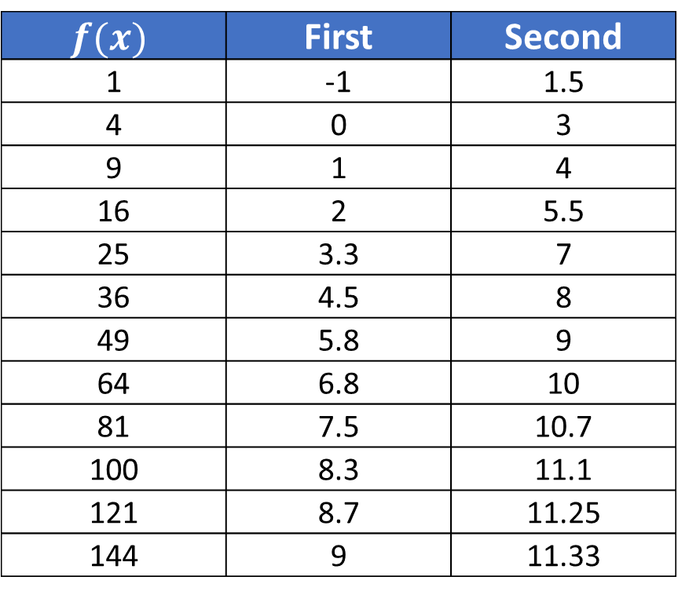
Simple Non-linear Example
$$f(x)$$ | First | Second
1 | -1 | 1.5
4 | 0 | 3
9 | 1 | 4
16 | 2 | 5.5
25 | 3.3 | 7
36 | 4.5 | 8
49 | 5.8 | 9
64 | 6.8 | 10
81 | 7.5 | 10.7
100 | 8.3 | 11.1
121 | 8.7 | 11.25
144 | 9 | 11.33
Notes:
Let’s take a simple example. I want to draw a line between these two datasets—first and second. I know that they are different classes and I want to find a function that will create an upper support vector that allow me to assign first to one class and a lower support vector that will allow me to assign second to another.
F of x is my function against which these two classes of datapoints are plotted (the x-axis).

Slide 29
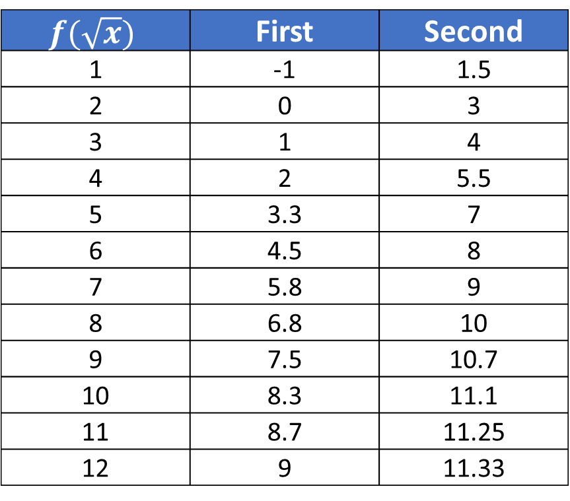
Simple Non-Linear Example
$$f(\sqrt{x})$$ | First | Second
1 | -1 | 1.5
2 | 0 | 3
3 | 1 | 4
4 | 2 | 5.5
5 | 3.3 | 7
6 | 4.5 | 8
7 | 5.8 | 9
8 | 6.8 | 10
9 | 7.5 | 10.7
10 | 8.3 | 11.1
11 | 8.7 | 11.25
12 | 9 | 11.33
Notes:
However, if I apply the squareroot function to the x values I can now create a linear separation. The datapoints themselves are unchanged. The only thing that has changed is the function of x. Where the previous chart showed the x axis ranging from 1 to 144, it now ranges only from 1 to 12—creating linearly separability between the two classes of data.

Slide 30
Nonlinear Support Vector Machines
Good for smaller data sets
No assumption of probability distribution
Converts 2d to multidimensional space
Common methods:
Polynomial kernel
Radial Basis Function
Sigmoid kernel
Gaussian kernel
Exponential kernel
Among others… *
Choosing the correct kernel is a non-trivial task

Slide 31
Other Non-linearly Separability Data Sets
X₂
X₂
X₁
X₁
Separation in non-linear data sets is accomplished using a kernel function, of which there are several
Notes:
As with these examples, we have data that cannot easily and with high accuracy be separated by a hyperplane. So what we have to do is figure out how we might project the datapoints into a multi-dimensional space so that we can once again have separability.

Slide 32
Non-Linear SVM Summary
Map the input space to a high dimensional feature space and learn a linear decision boundary in the feature space
The decision boundary will be nonlinear in the original input space
Many possible choices of kernel functions
How to choose? Most frequently used method: cross‐validation

Slide 33
Kernel Trick: Advantages and Caveats
Useful in high-dimensional spaces – can work even when the number of dimensions is greater than examples (Caveat: predictive capability may be poor)
Features are non-parametric (Caveat: computational cost)
Not constricted to a “distribution”
In theory, infinite, thus are “assumption free” model
Reduced chances of the ‘curse of dimensionality’
Kernel functions can be added together (be ensembles) to create even more complex hyperplanes (Caveat: computational cost)
Give a highly optimal hyperplane (Caveat: no probability functions)

Slide 34
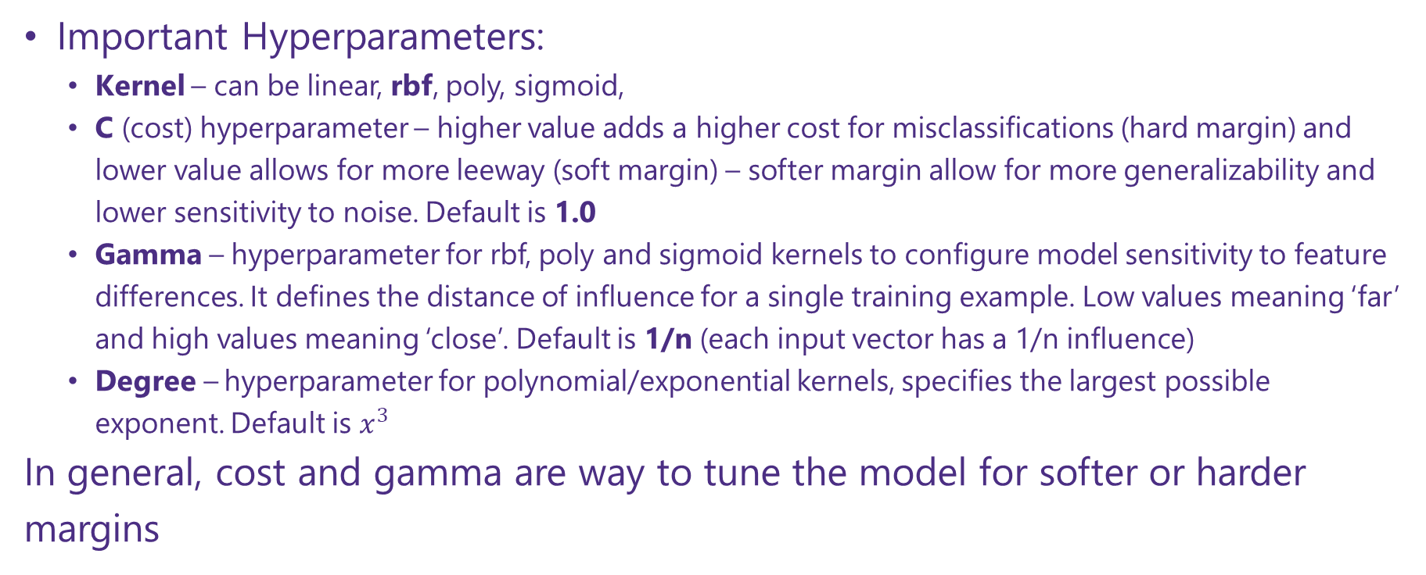
Parameters in Support Vector Classification
sklearn.svm.svc
Important Hyperparameters:
Kernel – can be linear, rbf, poly, sigmoid,
C (cost) hyperparameter – higher value adds a higher cost for misclassifications (hard margin) and lower value allows for more leeway (soft margin) – softer margin allow for more generalizability and lower sensitivity to noise. Default is 1.0
Gamma – hyperparameter for rbf, poly and sigmoid kernels to configure model sensitivity to feature differences. It defines the distance of influence for a single training example. Low values meaning ‘far’ and high values meaning ‘close’. Default is 1/n (each input vector has a 1/n influence)
Degree – hyperparameter for polynomial/exponential kernels, specifies the largest possible exponent. Default is $x^{3}$
In general, cost and gamma are way to tune the model for softer or harder margins

Slide 35
Notebook Time

Slide 36
Appendix

Slide 37
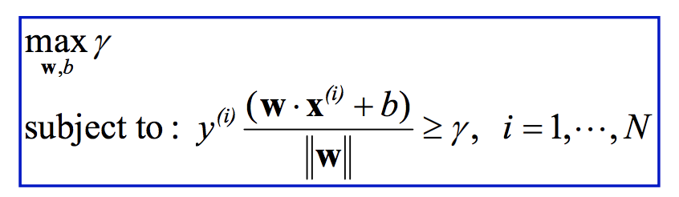
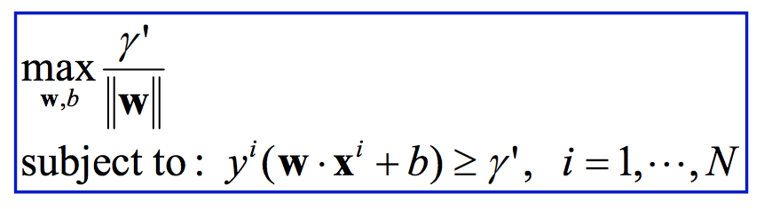
Maximum Margin Classifier
This can be represented as a constrained optimization problem.
This optimization problem is in a nasty form, so we need to do some rewriting.
Let γ’ = γ ⋅ ||w|| , we can rewrite this as

Slide 38
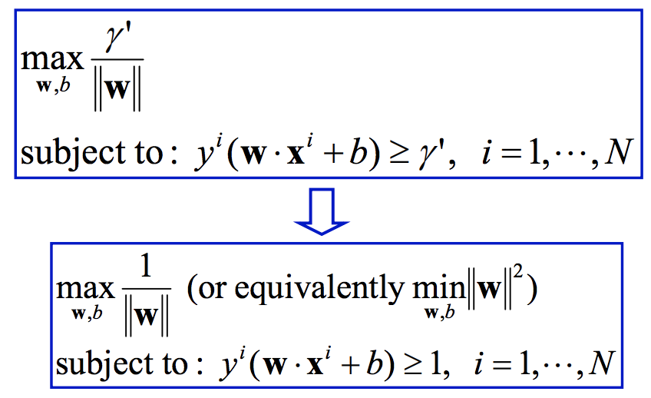
Maximum Margin Classifier con’t
Note that we can arbitrarily rescale w and b to make the functional margin γ’ large or small.
So we can rescale them such that γ’ = 1.

Slide 39
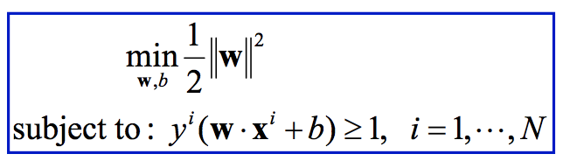
Solve the Optimization Problem
This is a quadratic optimization problem with linear inequality constraints.
This is a well-known class of mathematical programming problems for which several (non-trivial) algorithms exist.
The solution involves constructing a dual problem where a Lagrange multiplier α_{i} is associated with every inequality constraint in the primal (original) problem.

Slide 40
Solution
We can not give you a closed form solution that you can directly plugin in and compute for an arbitrary data sets.
The solution can always be written in the following form

Slide 41
Solution Cont.
The weight vector is a linear combination of all the training examples.
Importantly, many of the ⍺ are zeros. These points that have non-zero ⍺ are the support vectors.
Solve the optimization problem involved computing the inner products x_{i}^{T}x_{j} between all training points.

Slide 42
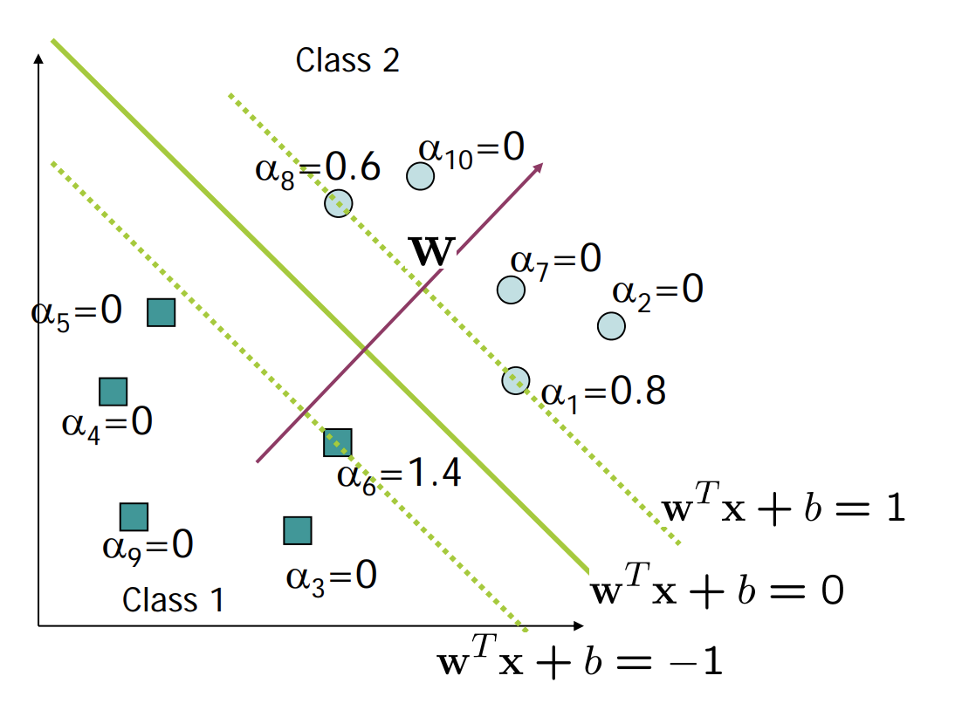
A Geometrical Interpretation

Slide 43
Geometric Interpretation
W^{T}x + b = 0 gives the decision boundary.
W^{T}x + b = 1 positive support vectors lie on this line.
W^{T}x + b = -1 negative support vectors lie on this line.
The decision boundary can be thought of now as a tube of certain width where no points can be inside the tube.
Implies that only support vectors matter; other training examples are ignorable.

Slide 44
Summarization So Far
We defined margin (functional, geometric)
We demonstrated that we prefer to have linear classifiers with large geometric margin.
We formulated the problem of finding the maximum margin linear classifier as a quadratic optimization problem.
This problem can be solved using efficient QP algorithms that are available.
The solution are very nicely formed.

Slide 45
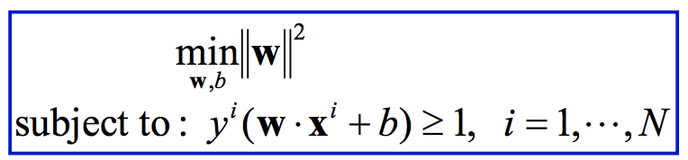
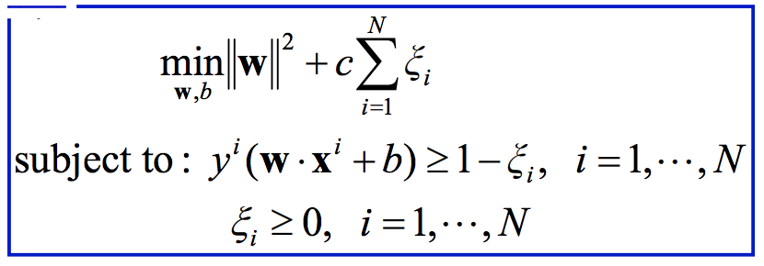
Soft Margin Maximization
Introduce slack variables ξ_{i} to allow some examples to have functional margins smaller than 1.

Slide 46
Hyper-parameter C
Effect of parameter c:
Controls the tradeoff between maximizing the margin and fitting the training examples
Large c: slack variables incur large penalty, so the optimal solution will try to avoid them
Small c: small cost for slack variables, we can sacrifice a few training examples to ensure that the classifier margin is large

Slide 47
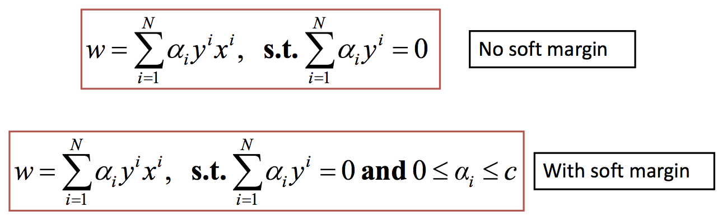
Solution to SVM with Soft Margin
c controls the tradeoff between maximizing margin and fitting training data.
It’s effect is to put a box constraint on α (the weights of the support vectors).
It limits the influence of individual support vectors (maybe outliers).
In practice, c can be set by cross‐validation.

Slide 48
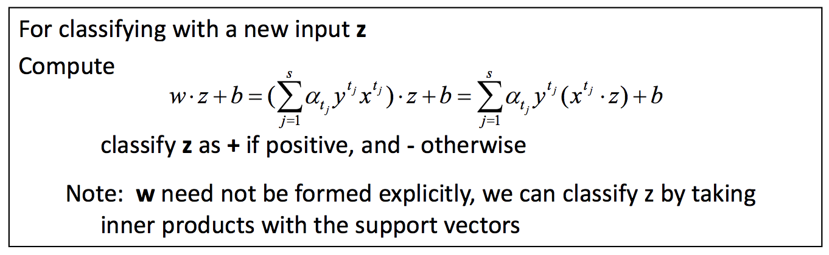
Make predictions with SVM

Slide 49
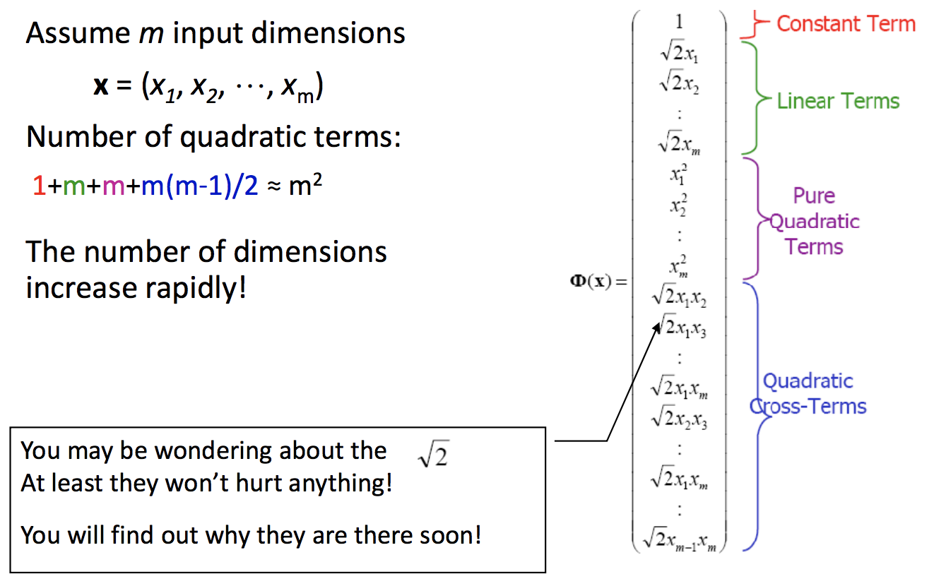
Quadratic Feature Space

Slide 50
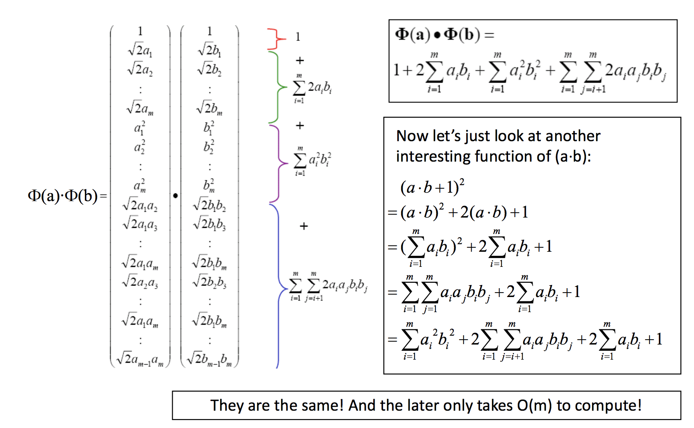
Dot product in quadratic feature space

Slide 51


Kernel Functions
If every data point is mapped into high‐dimensional space via some transformation x → φ(x), the inner product that we need to compute for classifying a point x becomes:
A kernel function is a function that is equivalent to an inner product in some feature space.
Thus, a kernel function implicitly maps data to a high-dimensional space (without the need to compute each φ(x) explicitly).

Slide 52
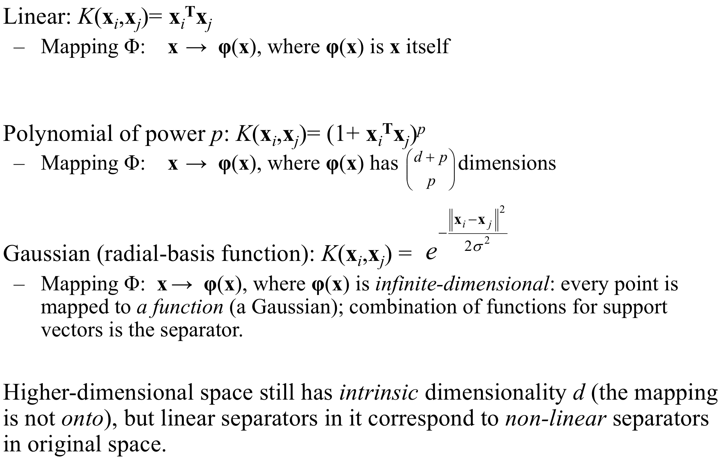
More Kernel Functions

